Slide 1
Providers and Parents as partners in using ASQ3 IN A VIRTUAL Environment

Slide 2
Head Start Performance Standards
1302.33 Child Screenings and Assessments
(A) Screening
1. In collaboration with each child’s parent and with parental consent, a program must complete or obtain a current developmental screening to identify concerns regarding a child’s developmental, behavioral, motor, language, social, cognitive, and emotional skills within the 45 calendar days of when the child first attends the program or, the first home based program option, receives a home visit.

Slide 3
Ages & Stages Questionnaire
ASQ-3 (Developmental Screen)
Ages & Stages Questionnaires, (ASQ-3) is a developmental screening tool designed for use by early educators and health care professionals to identify any early signs of developmental delays.

Slide 4
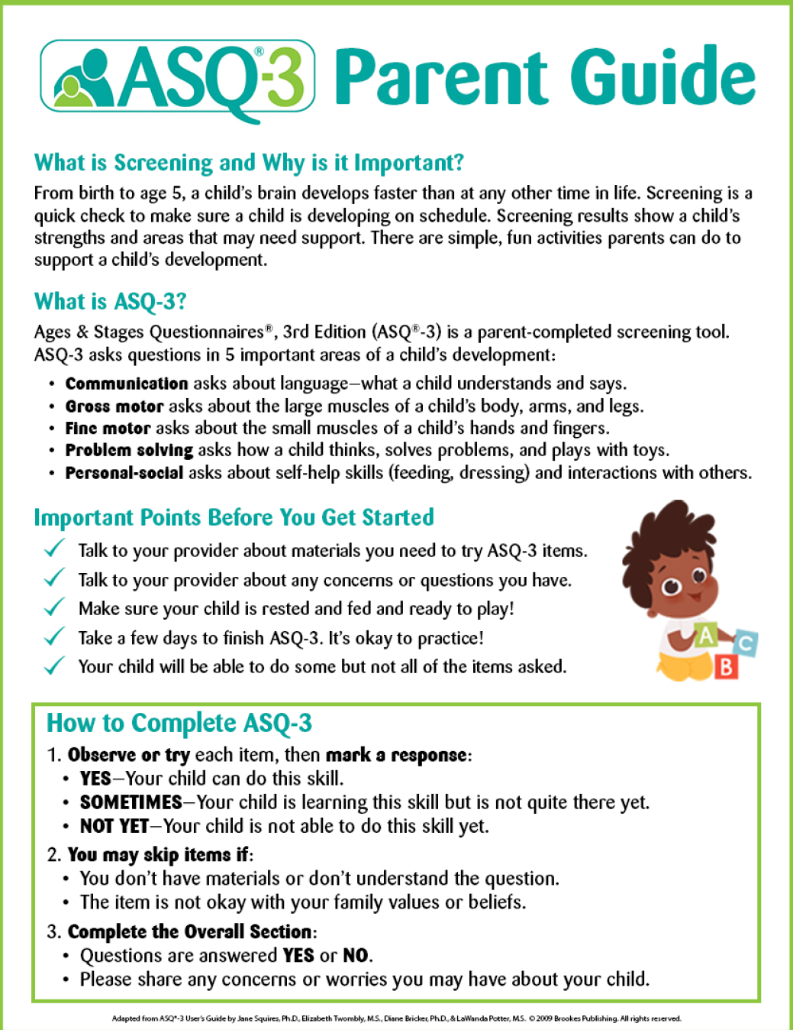
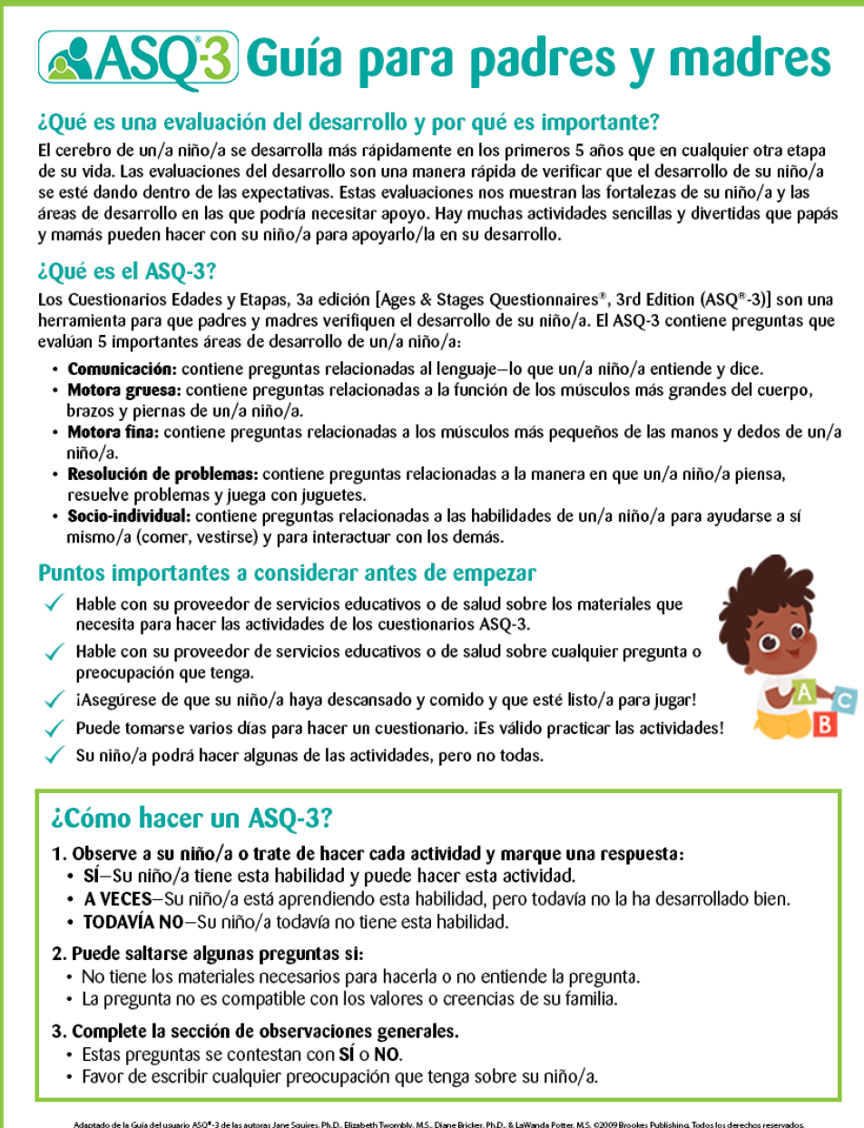
RESOURCES TO SHARE WITH PARENTS
Materials needed to administer asq3
ASQ PARENT GUIDE ENGLSIH / SPANISH

Slide 5
Questionnaire Delivery: Text
*ASK parent if child is premature (upon scheduling Home Visits)
*If yes, child’s age will need to be adjusted using ASQ calculator.
Special Release of ASQ-3 questionnaires in JPEG format; one image per questionnaire page.
Images can be texted to parents who don’t have internet access
Images can be used by professionals who don’t currently have access to programs' ASQ-3 box, files or ASQ online
Includes fillable PDF of information Summary sheets for professionals to use to record responses and scores
May be used to support virtual one on one parent conferences by direct service providers.

Slide 6
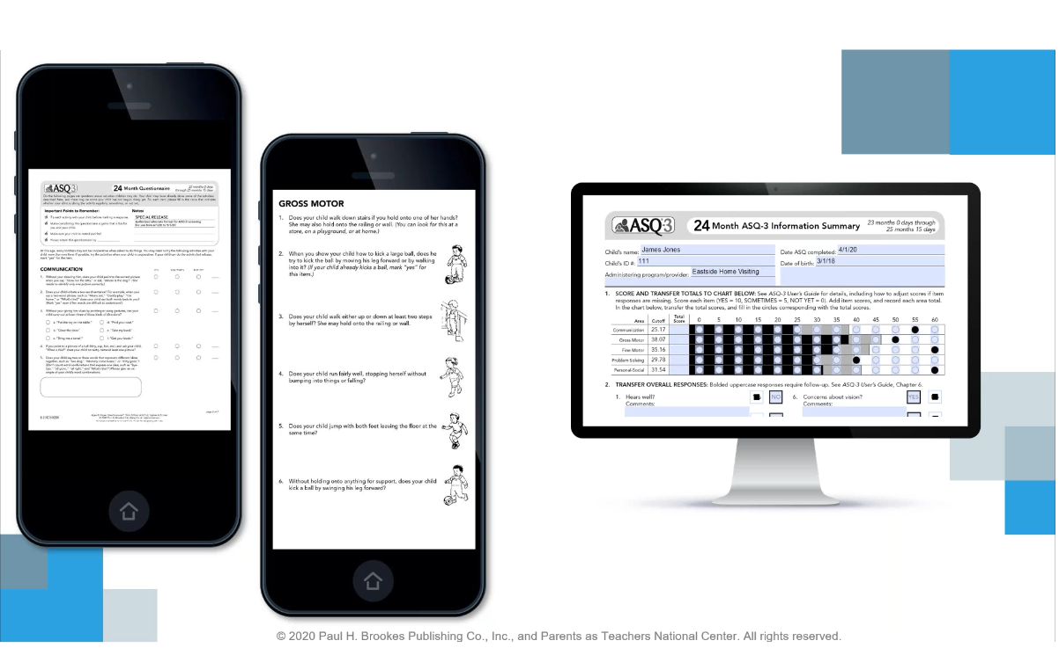
Parents can view JPEG pictures of questionnaire or teacher can share questions via interview with parent
Fillable Summary Score sheet
Teacher will save each sheet per family and keep for records.

Slide 7
pdf Pictures are available in English
Spanish pdf pictures ARE NOT AVAILABLE BUT EACH Spanish questionnaire will be available on the www.ehsflexpd.com website under education and teachers will read each question to parent
Takes 10–15 minutes for parents to complete with teacher via interview
Capture parents’ in-depth knowledge about their child
Teachers Note down a child’s strengths as well as concerns
Teaches parents about child development and their own child’s skills
Highlight results that fall in a “monitoring zone,” to make it easier to keep track of children at risk
Can be completed via virtual conference or over the phone during this COVID:19 pandemic time

Slide 8
1. ASQ3 MUST BE COMPLETED Within 45 calendar days of when the child first attends the program
2. Legal guardian answers ASQ’s via phone conference with teacher
3. Teacher reviews ASQ’s. Any questions and/or concerns with the completion of the ASQ’s will be discussed and clarified during home visit.
4.Teacher reviews before uploading into one drive for center managers/ site directors / coaches/ easter seals and disability managers to review
5. If child scores in monitor area (gray), teacher will note down on sheet of paper or notebook for keepsake and provide activities using the asq3 strategies and open Individualization based on scores.
6. If Child scores in area of concern (black) or there is a parent concern, teacher will note and complete a referral form and submit to center manage/ site director/ and disabilities program manager via email.

Slide 9
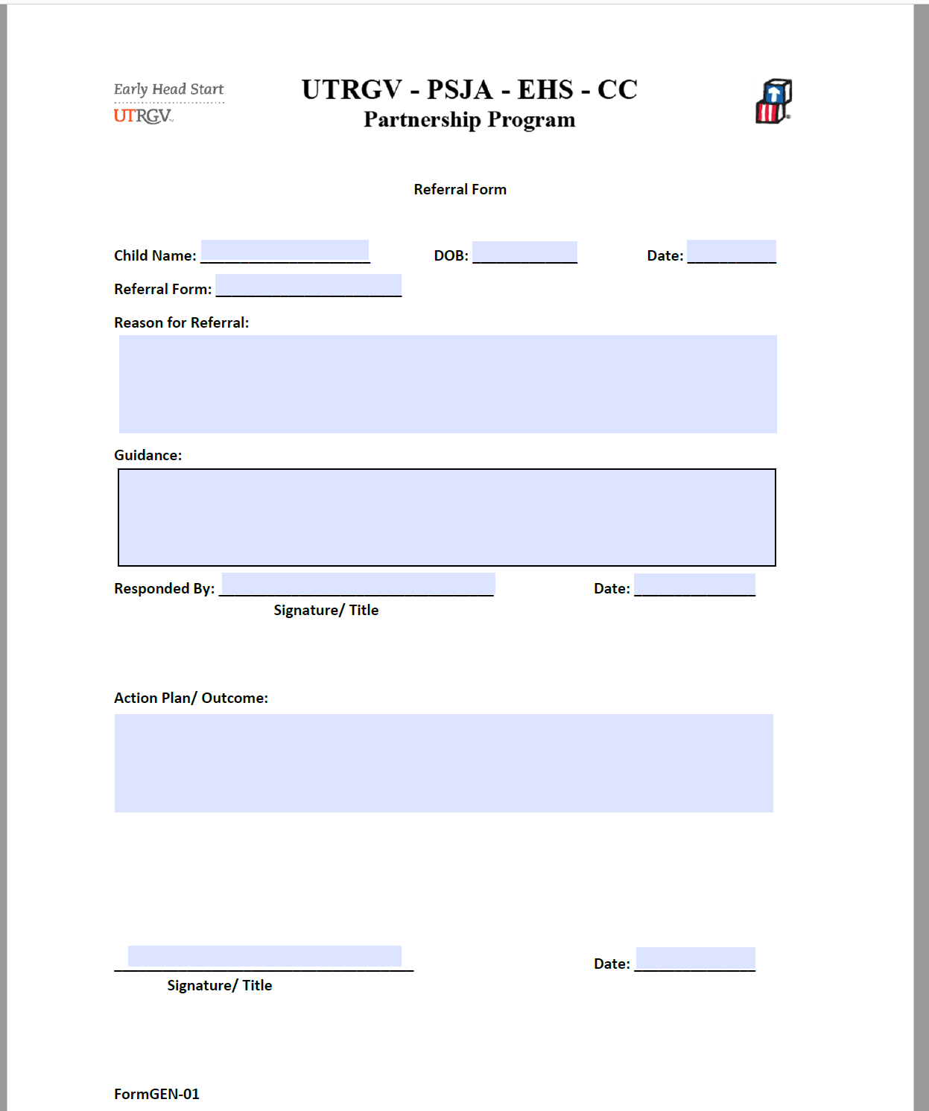
Fill out Form

Slide 10
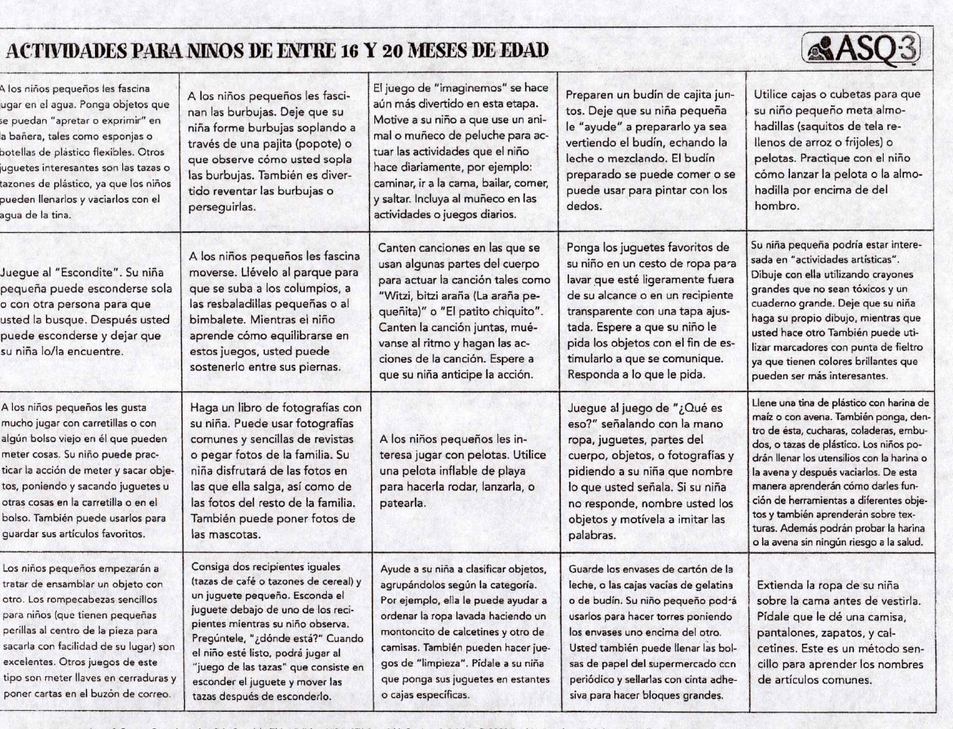
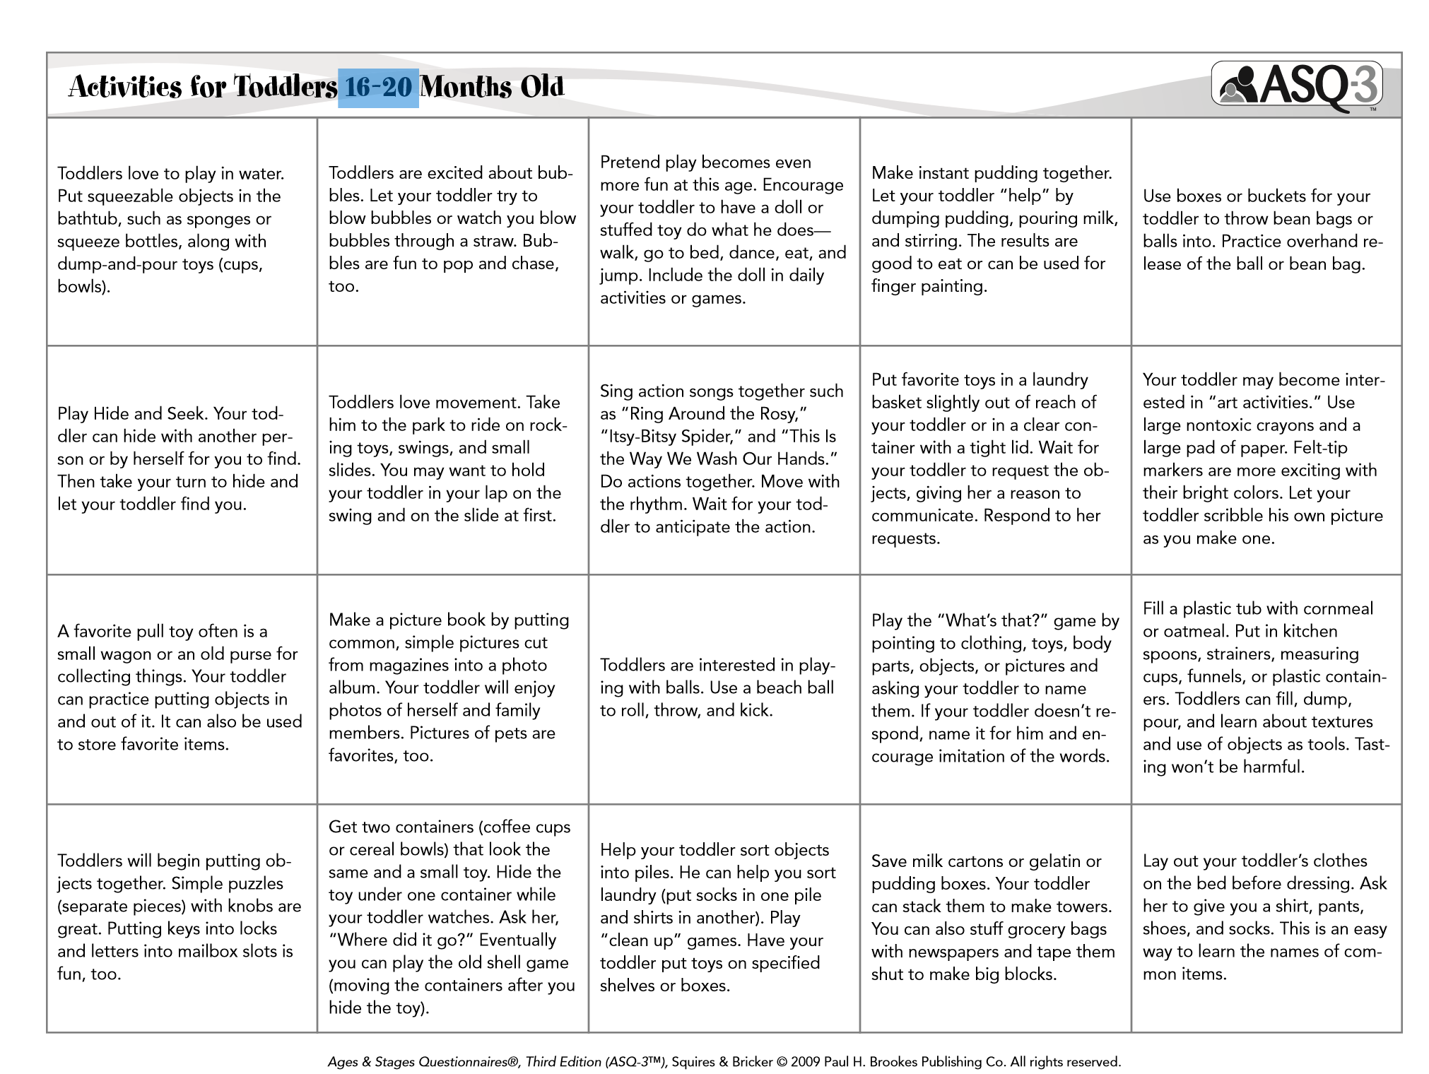
ASQ 3 STRATEGIES
ASQ3 strategies in English and Spanish will be available in the website www.ehsflexpd.com under “Education AD Disabilities”

Slide 11
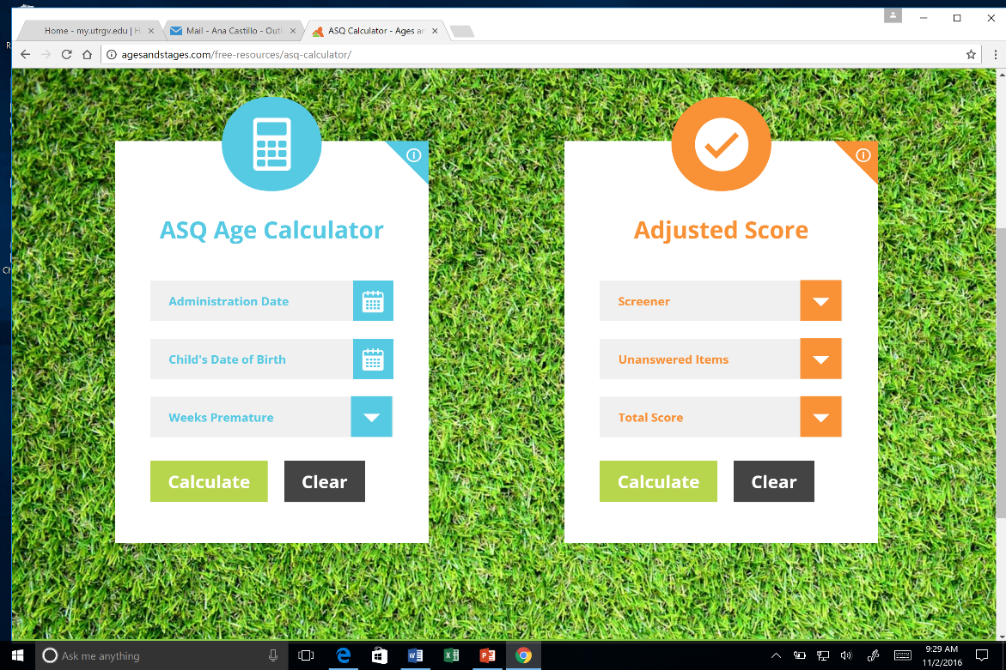
ASQ AGE CALCULATOR
http://agesandstages.com/free-resources/asq-calculator/

Slide 12
QUESTIONS?
Thank you

